Slide 1
Detection of sand on belt conveyor

Slide 2
Introduction
Goal of our project is to classify sand or rock piles carried on a belt conveyor to get information on the condition of the belt conveyor
The first step needed for classification is to crop the image by removing unwanted areas of the image
In our case, we are only interested in sand on the belt conveyor, so we detect the sand piles and cut off the surroundings

Slide 3
Sand detection on belt conveyor
Detection process includes two steps:
Detection of belt conveyor
As the surroundings might be noisy making sand detection difficult, we first detect the belt conveyor and remove the surroundings
Detection of sand pile
Detect sand on the belt conveyor using thresholding
Draw bounding box around detected sand and crop the image to this box

Slide 4
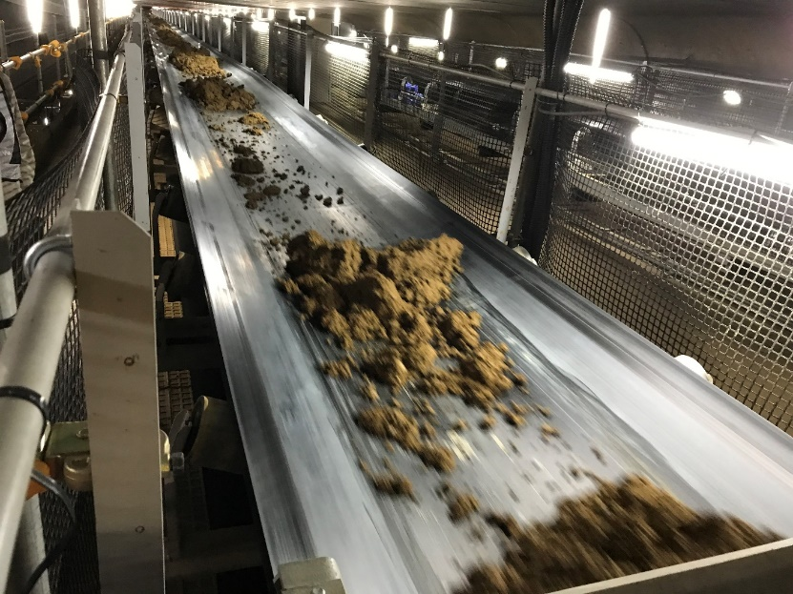
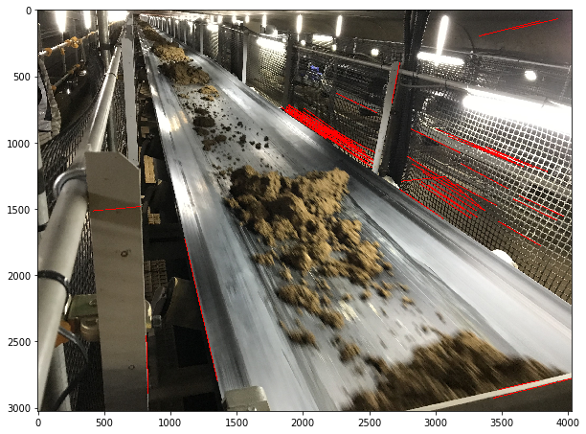
1. Detection of belt conveyor
Borders of a belt conveyor are defined by straight lines, so we search for lines in the image
For that, we first apply a Canny edge detector and then the Hough line transform
Canny edge + Hough transform
(red lines: result of Hough transform)
Original image

Slide 5
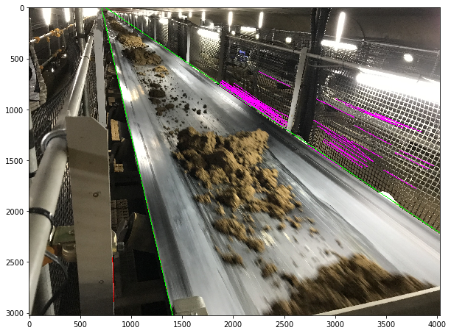
1. Detection of belt conveyor
We just need the border lines (1 on the left and 1 on the right side of the belt conveyor)
Thus, divide lines into left and right side by using k-means clustering
Clustering:
First, check slope values of the line segments
If there are more positive values, delete lines with negative slope value, as those are not in the direction of the belt
If there are more negative values, delete lines with positive value
Apply k-means clustering with 2 clusters to the center points of the line segments
For the left group, find rightmost line, for the right group, find leftmost line and extend the found lines along whole image
Delete lines with completely different direction + group lines by clustering
(red: left group, purple: right group,
green: extended lines each for left and right group)

Slide 6
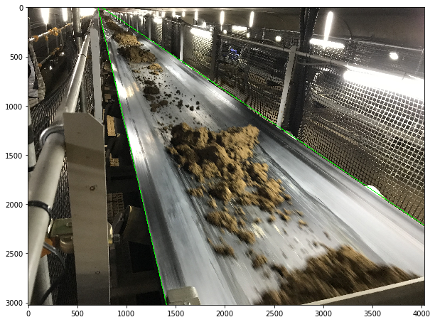
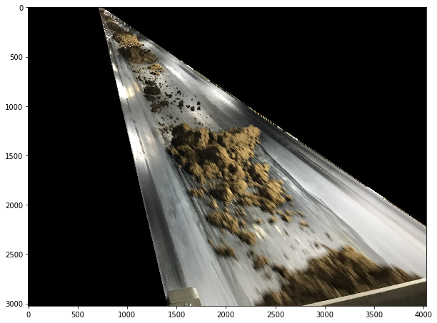
1. Detection of belt conveyor
Remove everything that is outside the 2 border lines
Remove surroundings

Slide 7
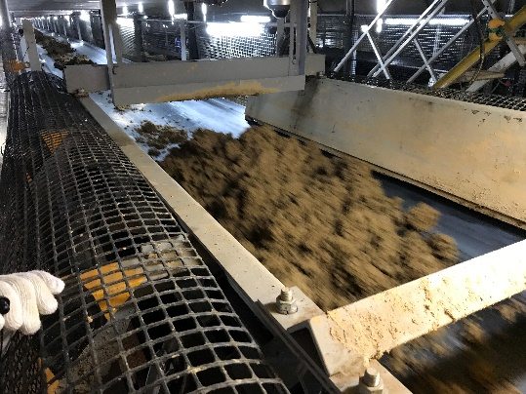
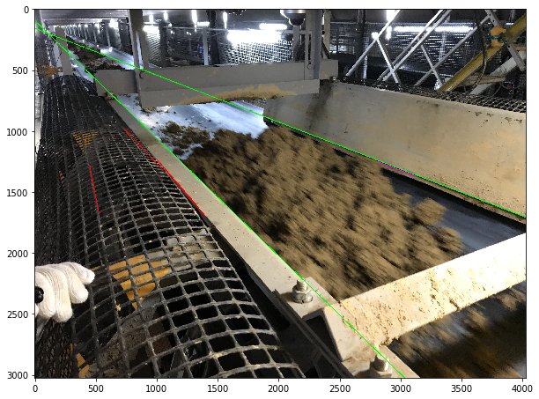
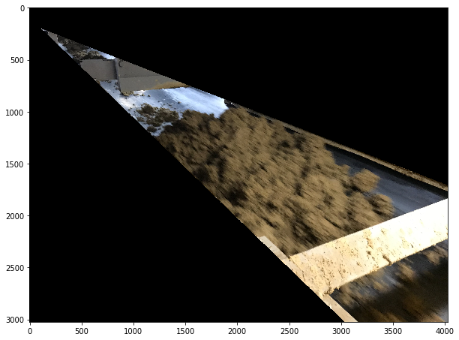
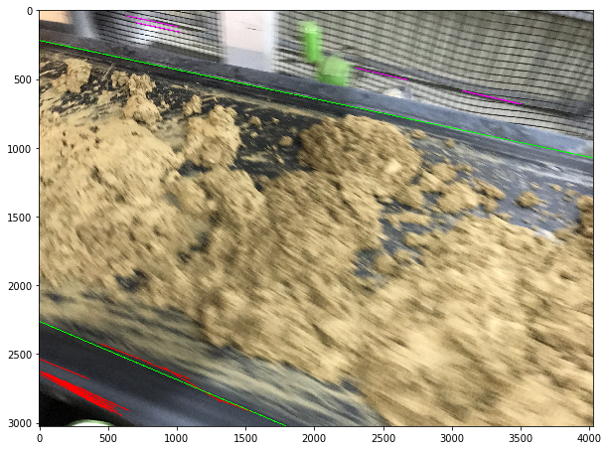
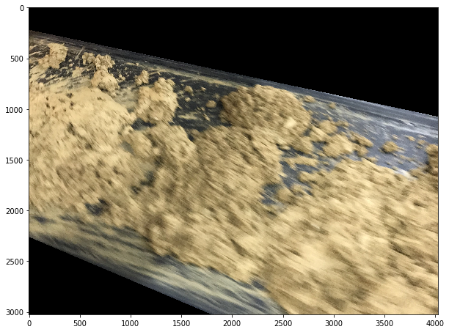
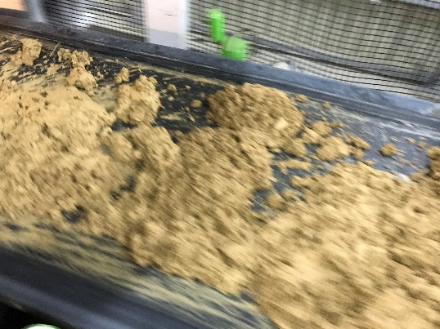
1. Detection of belt conveyor
Using clustering, we can cope with different viewpoints

Slide 8
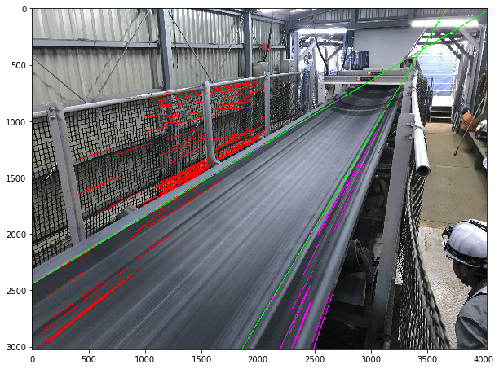
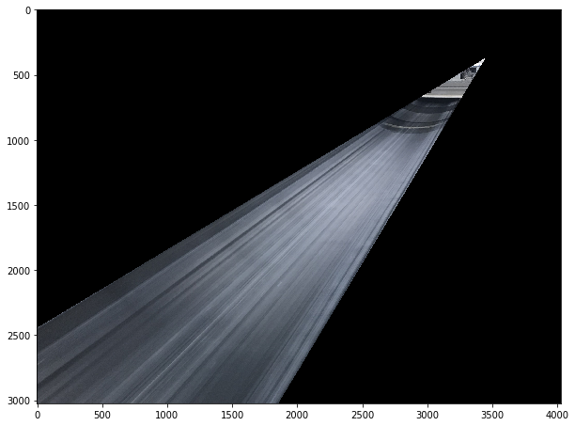
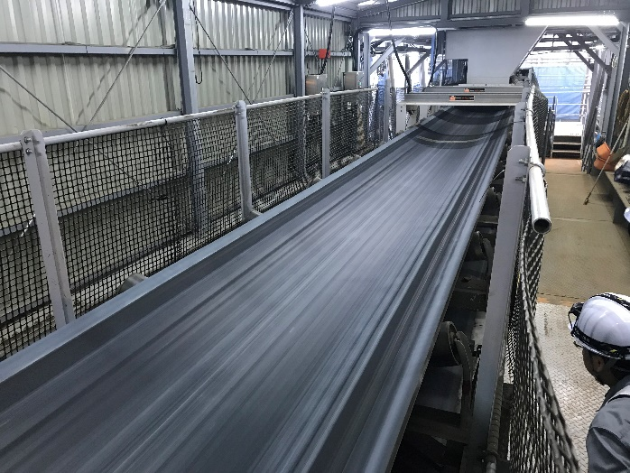
1. Detection of belt conveyor
Using clustering, we can cope with different viewpoints

Slide 9
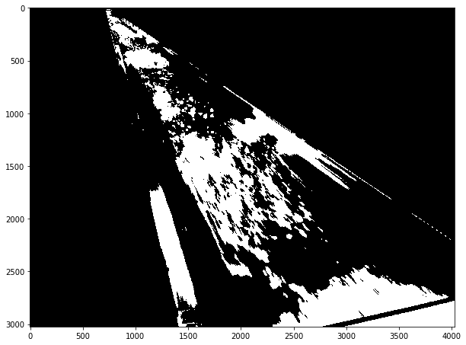
2. Sand detection
Smooth image using Gaussian blur
Then, apply thresholding to detect sand lying on the belt
Gaussian blur
+ thresholding

Slide 10
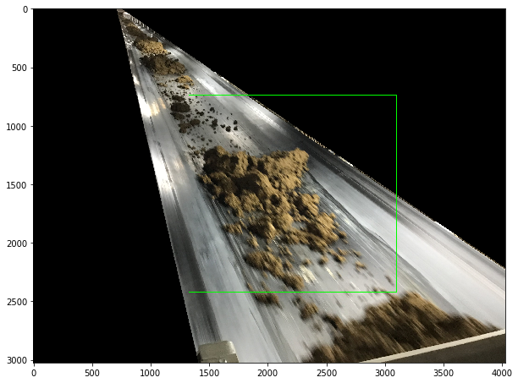
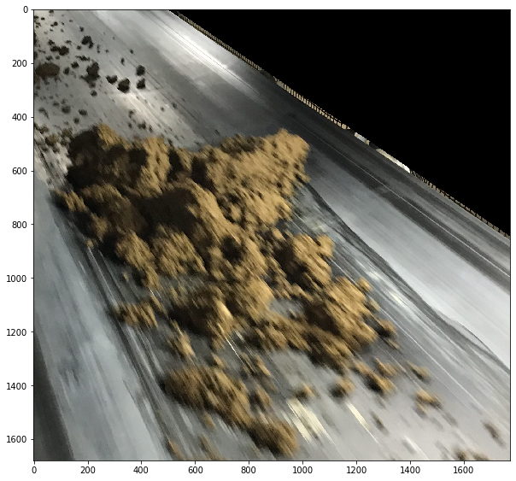
2. Sand detection
extract contours using OpenCV’s function findContours
Find bounding box of largest contour
Crop image to box size
crop
Green: bounding box of largest contour
Resulting image

Slide 11
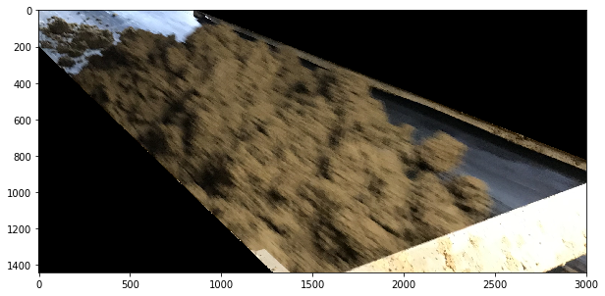
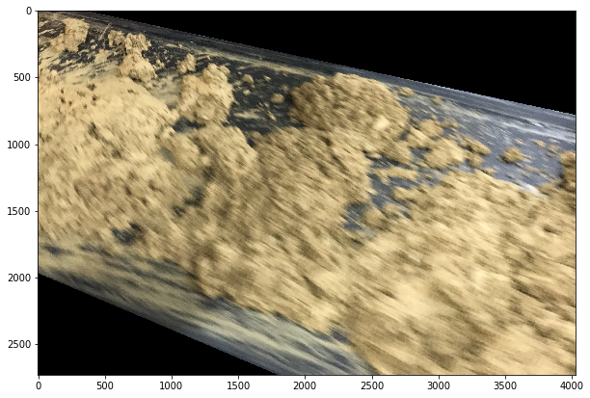
2. Sand detection
Other examples:
thresholding + cropping
thresholding + cropping

Slide 12
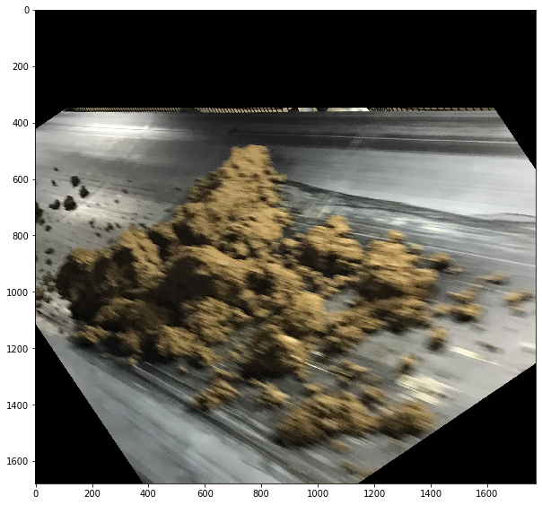
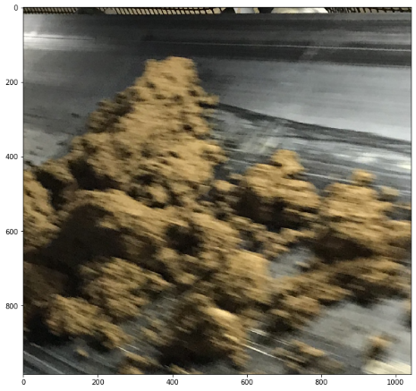
2. Sand detection
Further rotate and crop images to remove more background and put focus on sand
Rotate so that upper slope of the belt is horizontal
Find completely black regions, crop image with same proportions on all sides
rotate
crop
Resulting image

Slide 13
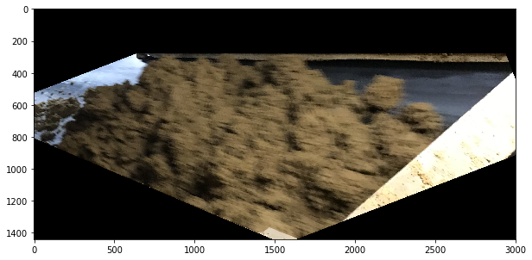
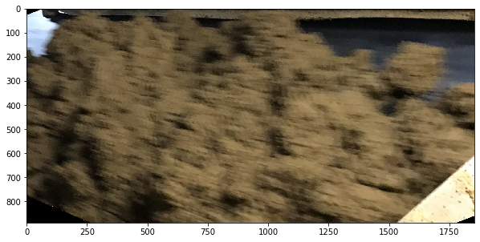
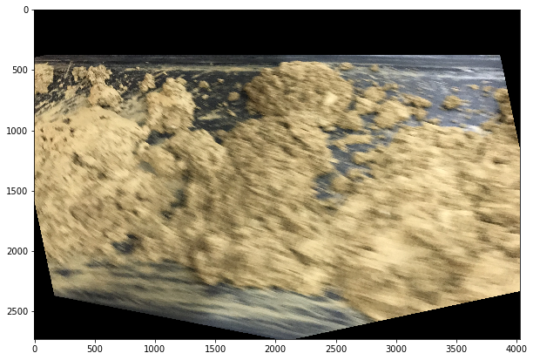
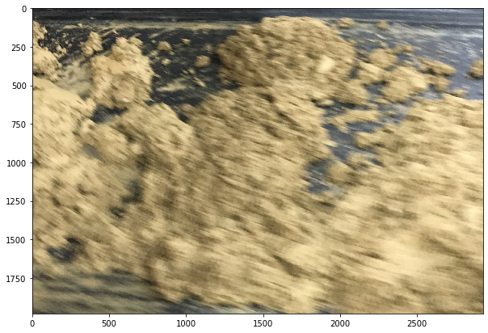
2. Sand detection
rotate
crop
Resulting image
rotate
crop
Resulting image

Slide 14
Outlook
The resulting images can be used for further processing to classify sand types
As the tested images are only some possible examples, values and parameters should be adjusted to the data that will be offered

